Slide 1
All About Me
By Yannis Ibrahim

Slide 2
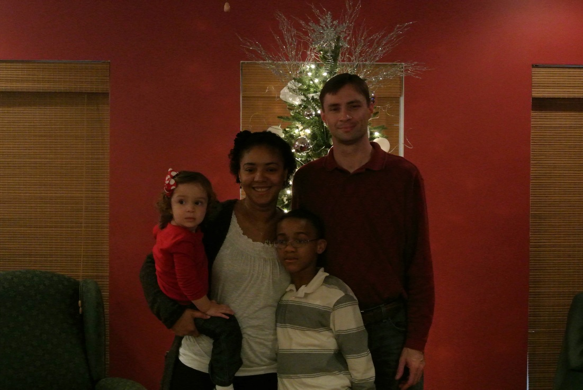
My Family
The people in my family include :
My Dad
My Mom
My Younger Sister
And me of course

Slide 3
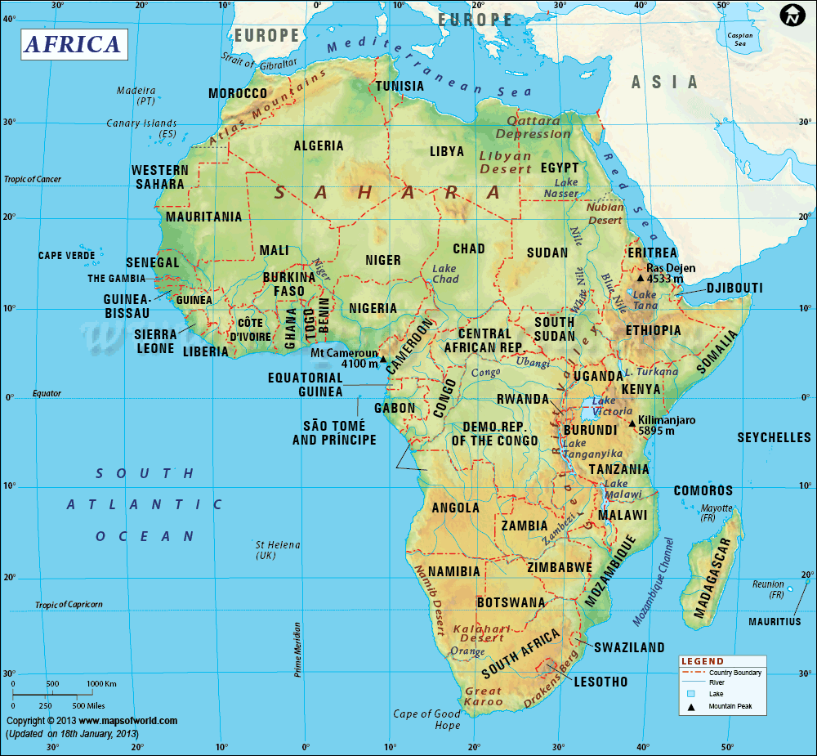
About My Family
My mom is from Africa.
Everybody in my family including me are good at board games.
My Mom is scared of lizards and snakes.
My Dad likes to watch Walking Dead.
My little sister likes to act crazy sometimes.

Slide 4
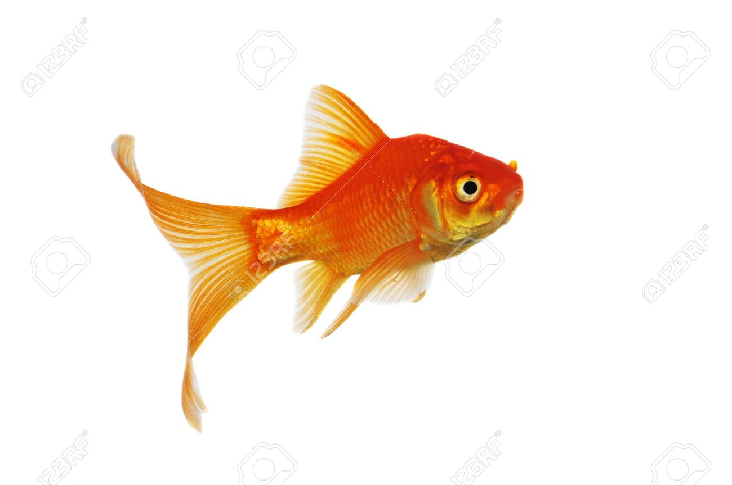
My Pets
I Have a pet Goldfish named Tangerine.
I call him Tangerine because he is a fresh, beautiful orange color and I love it so much.

Slide 5
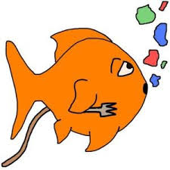
About Tangerine
Tangerine is a Comet Goldfish.
We don’t know his exact age but I think he could be at least 4 to 5 years at least.
He likes to eat algae-bacon flavored fish flakes.
He likes to hide from people he thinks are dangerous
Whenever he eats his fish food he likes to puke it back up and save it for later….gross!!!

Slide 6
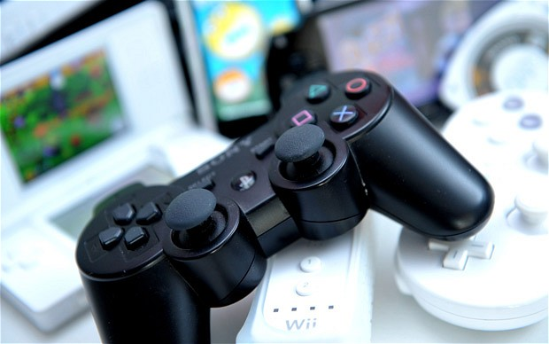
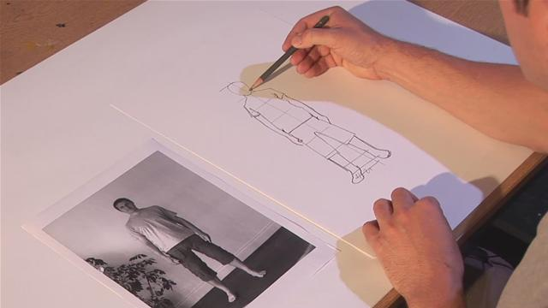
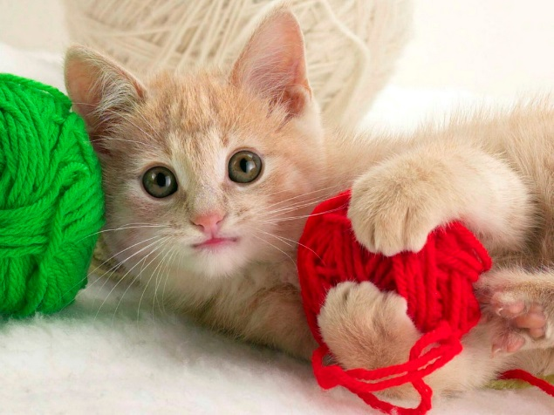
My Hobbies
Things that I like to do include:
Playing video games
Drawing
Playing with animals

Slide 7
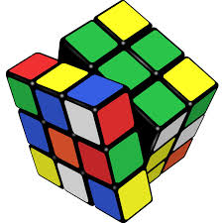
Things to know about My Hobbies
I am a master at video games and have so many explainable theories about video games and even figured out the entire story behind Five Nights at Freddy’s.
I can draw very well, things that I like to draw mainly include FNAF, but I am currently trying to learn how to draw other things.
I love animals they are all very cute. My favorite domestic animal is a cat and my favorite wild animal is a fox. Animals love me very much because I can tell how they feel.

Slide 8
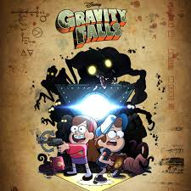
My Favorite TV Show
A TV show that I like to watch is Gravity Falls
It’s a show made by Disney that only shows on
Disney XD now.

Slide 9
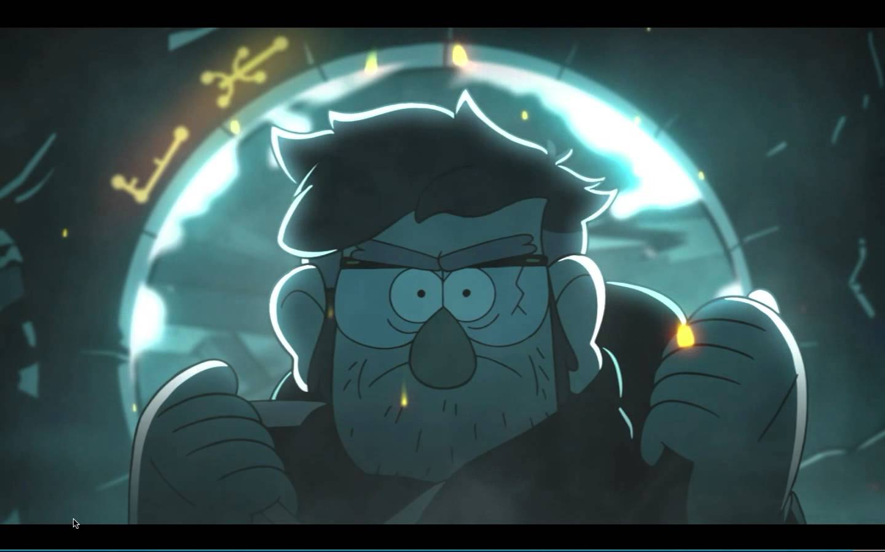
About Gravity Falls
Gravity Falls is about two twins named Mabel and Dipper.
They explore mysteries and paranormal activity in a small town called Gravity falls with there cheap Gruncle Stan who owns a shop called the mystery shack.
There are about 2 seasons so far in gravity falls and they are about to end the series with a 3 part episode called Weirdmaggedon.

Slide 10
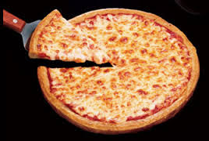
My Favorite Food
I actually have three favorite foods but my favorite food in the entire world is pizza.
Pizza has been a major part of what I eat, though I am not one of those crazy food loving people.

Slide 11
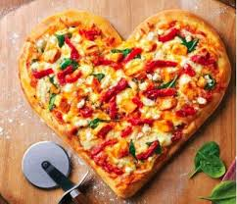
Why I Love Pizza
Pizza is just so cheesy and saucy.
It gives me a good feeling whenever a take a bite out of it.
I love how it is round and simple in shape, and how when you cut it cheese oozes out of its sides.
Sometimes the pizza can have stuffed crust and that can sometimes drive me nuts in a good way.

Slide 12
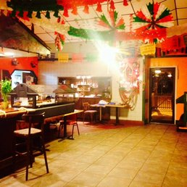
My Favorite Restaurant
My favorite restaurant is a Mexican restaurant that opened up a year ago named El Cerrito.
It is across from Cobb Fords road in Prattville.

Slide 13
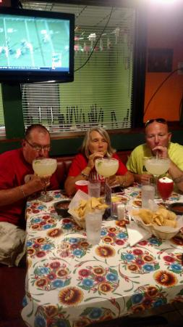
About El Cerrito
El Cerrito has lots of delicious Mexican food and good service.
I go there with my family all the time and when we do I like to order the Chicken Quesadilla and some extra salsa.
If you don’t feel like eating Mexican food while your there( and you’re an adult) there is a bar stand near the exit.
At 11o’clock they serve a lunch buffet with a build your own taco stand.

Slide 14
My Favorite Place to Shop
Because I like video games a lot, I like to shop at GameStop.
They have so many games, sometimes I like to look at them just because I feel like it.
One day when I have lots of money I am going to buy a collection of video games that I can keep and share with my friends.

Slide 15
Why I like to Shop at GameStop
GameStop has so many games and it is a really efficient source if you are looking for a game that you couldn’t find in Walmart or Target.
They never are sold out of a game, I mean it’s a game shop theres no way that they’d just so happen to not get a new supply of games to fill in for that one game that is sold out.
The employees know everything about games. They know about almost every game in the store and will not hesitate to give you any advice about how to handle with the game.

Slide 16
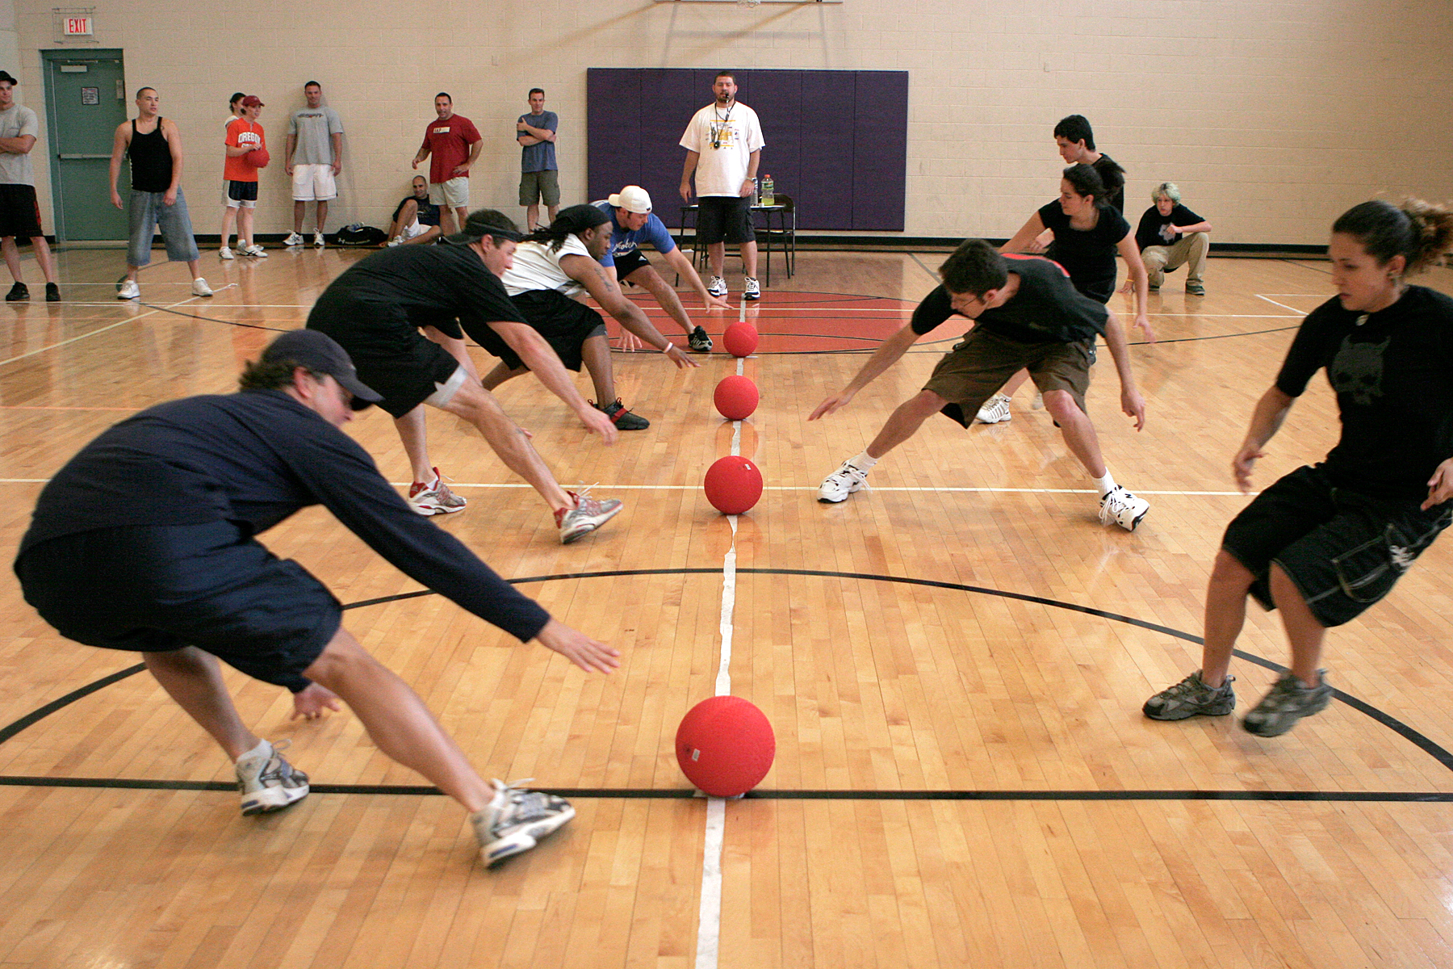
My Favorite Sport
My favorite sport to play is a classic school gym game, people like to call Dodge Ball.

Slide 17
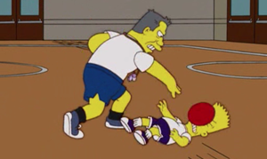
Why I like Dodge ball
Dodge ball is a very complex game about strategy and teamwork.
It teaches kids to be aware of their surroundings and what happens when you don’t pay attention.
Not many schools have played dodge ball in years but I am sure it will find a way into their routine.

Slide 18
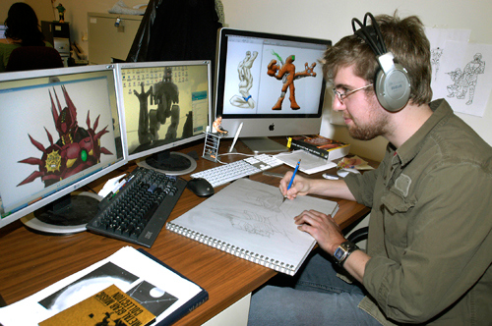
Future Career
My future career in life is to be a video game designer.
I am really wanting this job opportunity.
One day I am going to program the best game in the world.

Slide 19
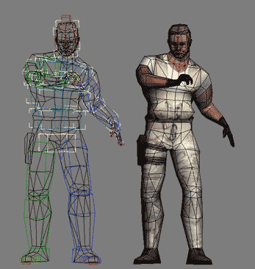
Why I am Interested in This Career.
It mixes all of my greatest interest into one super fun job I can do.
It will be hard to do from time to time but because it is something I like it won’t be as big as of a concern.
It allows me to be creative with myself and brings out y artistic interest.
I want to be able to make my way up to video game ideas man so I can show them my all new game idea “ Legendary Quests”.

Slide 20
The End
I hope you enjoyed my presentation.

